Slide 1
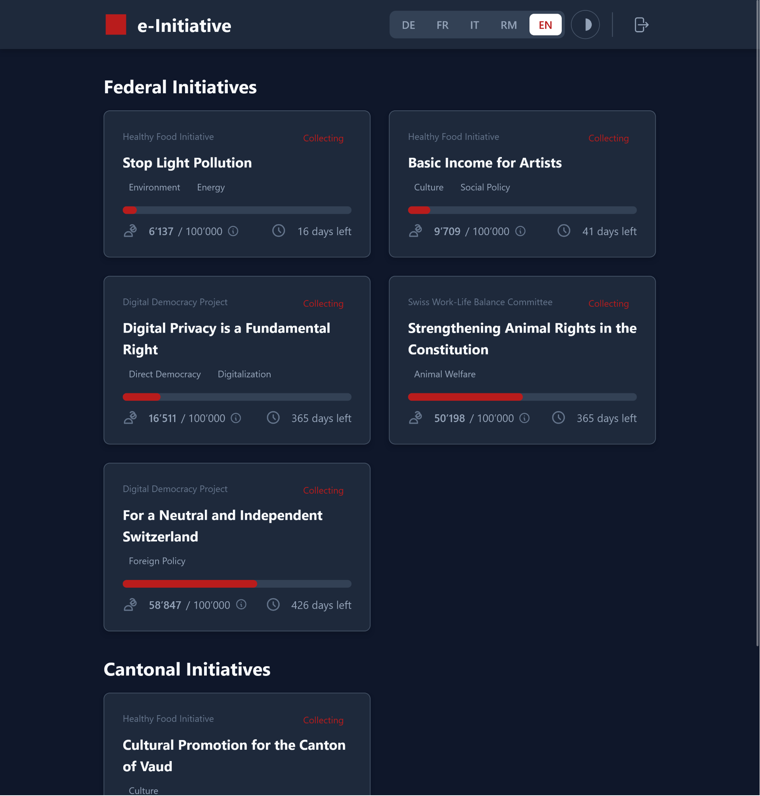
E - C O L L E C T I N G
G R O U P 1 2
S A M Y A N T O N I A Z Z I
L I O N E L S T Ü R M E R
Y A N N I C K R Ü F E N A C H T
A L F A D I O P - W I C K I
E - INITIATIVE
H A C K A T H O N - 0 1 . 1 1 . 2 0 2 5
Notes:
Title page
In this presentation, all 10 Topics are referenced:
1 - user journey
2 - current status
3 - notify counties/collectors
4 - list arguments of initiative
5 - identity proof => e-ID
6 - vote proof => e-ID
7 - vote secret => e-ID
8 - sync with paper based system
9 - paper based system receives votes
10 - ???

Slide 2





V O T I N G
J O U R N E Y
Flyer
Komittee of Paper-based System
1.
Website
2.
Registration
DB
Scan
E-Initiative.ch
Federal
Local
5.
QR
Canton
User
Export/ Validation
Manual validation
4.
A-Gov
3.
swiyu
Canton-Login
ID-Card
Store
Authorize
CH-Login

Slide 3
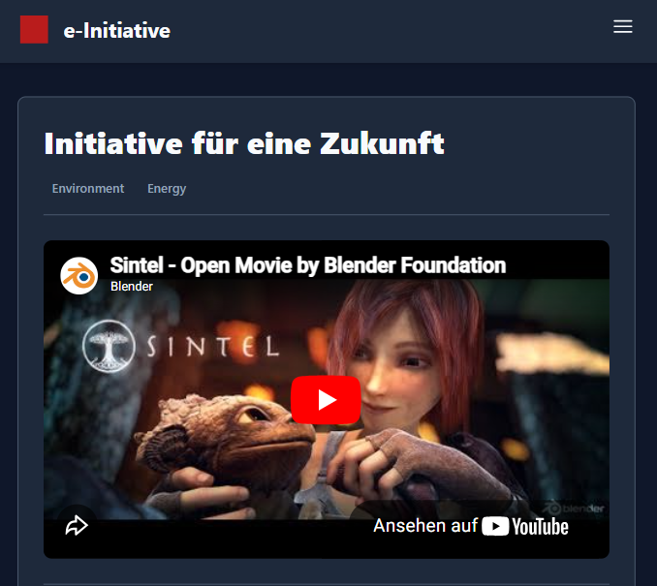
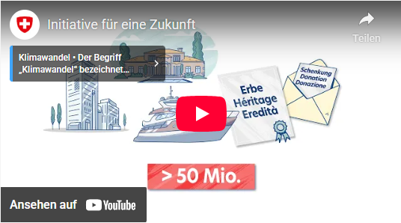
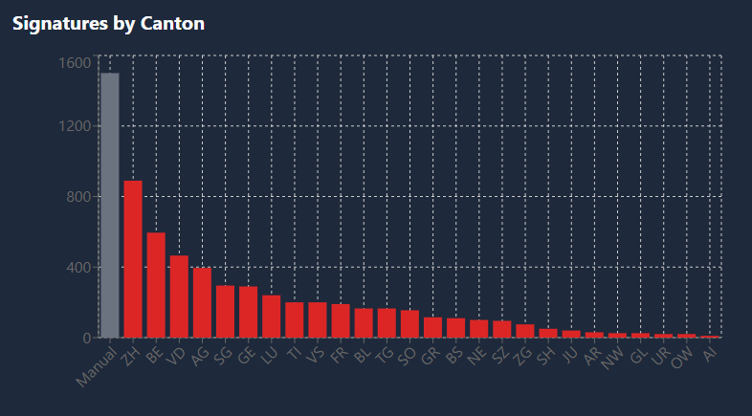
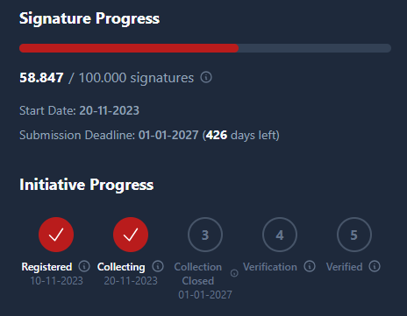
P L A T F O R M
B E N E F I T S
Status Updates
Export to Muncipality
E-ID Integration
Flexible to external needs

Slide 4
From willingness to signature
Unified, secure user flow — e-ID login and encrypted communication & data storage
Prevention of lost or hidden signatures
Is in the responsibility of the municipality. Referral codes allows committees to check the numbers.
1.
6.
Access to collected signatures
Personal information can only be decrypted by the municipality that needs them.
Protection of voting secrecy
Only the municipality has access on this information.
2.
7.
Attribution to committees
Referral code for each collecting party.
Integration with paper process
CVS export to integrate in existing systems, openness to adapting APIs.
T O P I C S
3.
8.
Information on e-collecting projects
Registration for newsletters is not the responsibility of the tool. The tool-administrator approves the content of the initiative.
Easy adoption for municipalities
User friendly - download functionality (CSV, PDF).
4.
9.
Exclusion of invalid signatures
Validation through e-ID.
Applicable to all federal levels
Cantonal and federal Initiative are supported, Municipal ones can be added.
5.
10.
Notes:
Topic addressed
1 From willingness to signature
Unified, secure user flow — e-ID login and encrypted communication & data storage.
2. Access to collected signatures
Personal information can only be decrypted by the municipality that needs them.
3. Attribution to committees
Referral code for each collecting party.
4. Information on e-collecting projects
Registration for newsletters is not the responsibility of the tool. The tool-administrator approves the content of the initiative.
5. Exclusion of invalid signatures
Validation through e-ID.
6. Prevention of lost or hidden signatures
Is in the responsibility of the municipality. Referral codes allows committees to check the numbers.
7. Protection of voting secrecy
Only the municipality has access on this information.
8. Integration with paper process
CVS export to integrate in existing systems, openness to adapting APIs.
9. Easy adoption for municipalities
User friendly - download functionality (CSV, PDF).
10. Applicable to all federal levels
Cantonal and federal Initiative are supported, Municipal ones can be added.

Slide 5
DEMO

